Slide 1
Tableau Project Coffee Data
Brandon Molnar
Summer 2022
ISDS 415-50 10150

Slide 2
Acquire & Clean The Data
Before the analysis could begin, the data had to be acquired and then cleaned. The data was loaded into Excel and the inconsistencies in the data were ironed out. The assumption was that the values in the sales, COGS, and total expenses columns were correct whereas several values in the profit and margin columns were incorrect. The static values in the profit and margin columns were replaced with the appropriate formulas to get the correct values and consistency that was needed. The following two slides provide a visual summary of the dirty data and the clean data. The “Sum of Columns” data at the bottom summarizes what has changed; this data was removed and then the sheet was opened into Tableau.

Slide 3
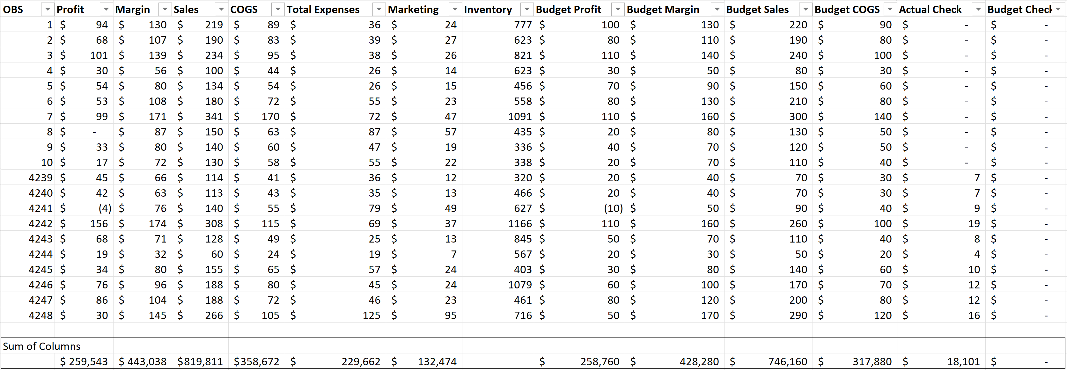
Acquire & Clean The Data – Dirty Data

Slide 4
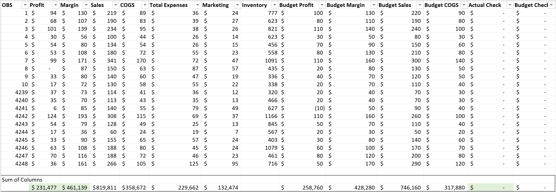
Acquire & Clean The Data – Clean Data

Slide 5
Product Overview
Question: What are some generic values that can be displayed to quickly visualize how each product has performed?
To understand which products have underperformed, each product was displayed side-by-side for a comparison. The next slide shows the sum of sales, COGS, margin, total expenses, and profits for each product (type) in the data set.
Observation: Based on the following bar chart, the first bar that stood out was the low profitability of Green Tea. After making this observation, it was quickly realized that it would be easier to gauge product performance based on percentages instead.

Slide 6
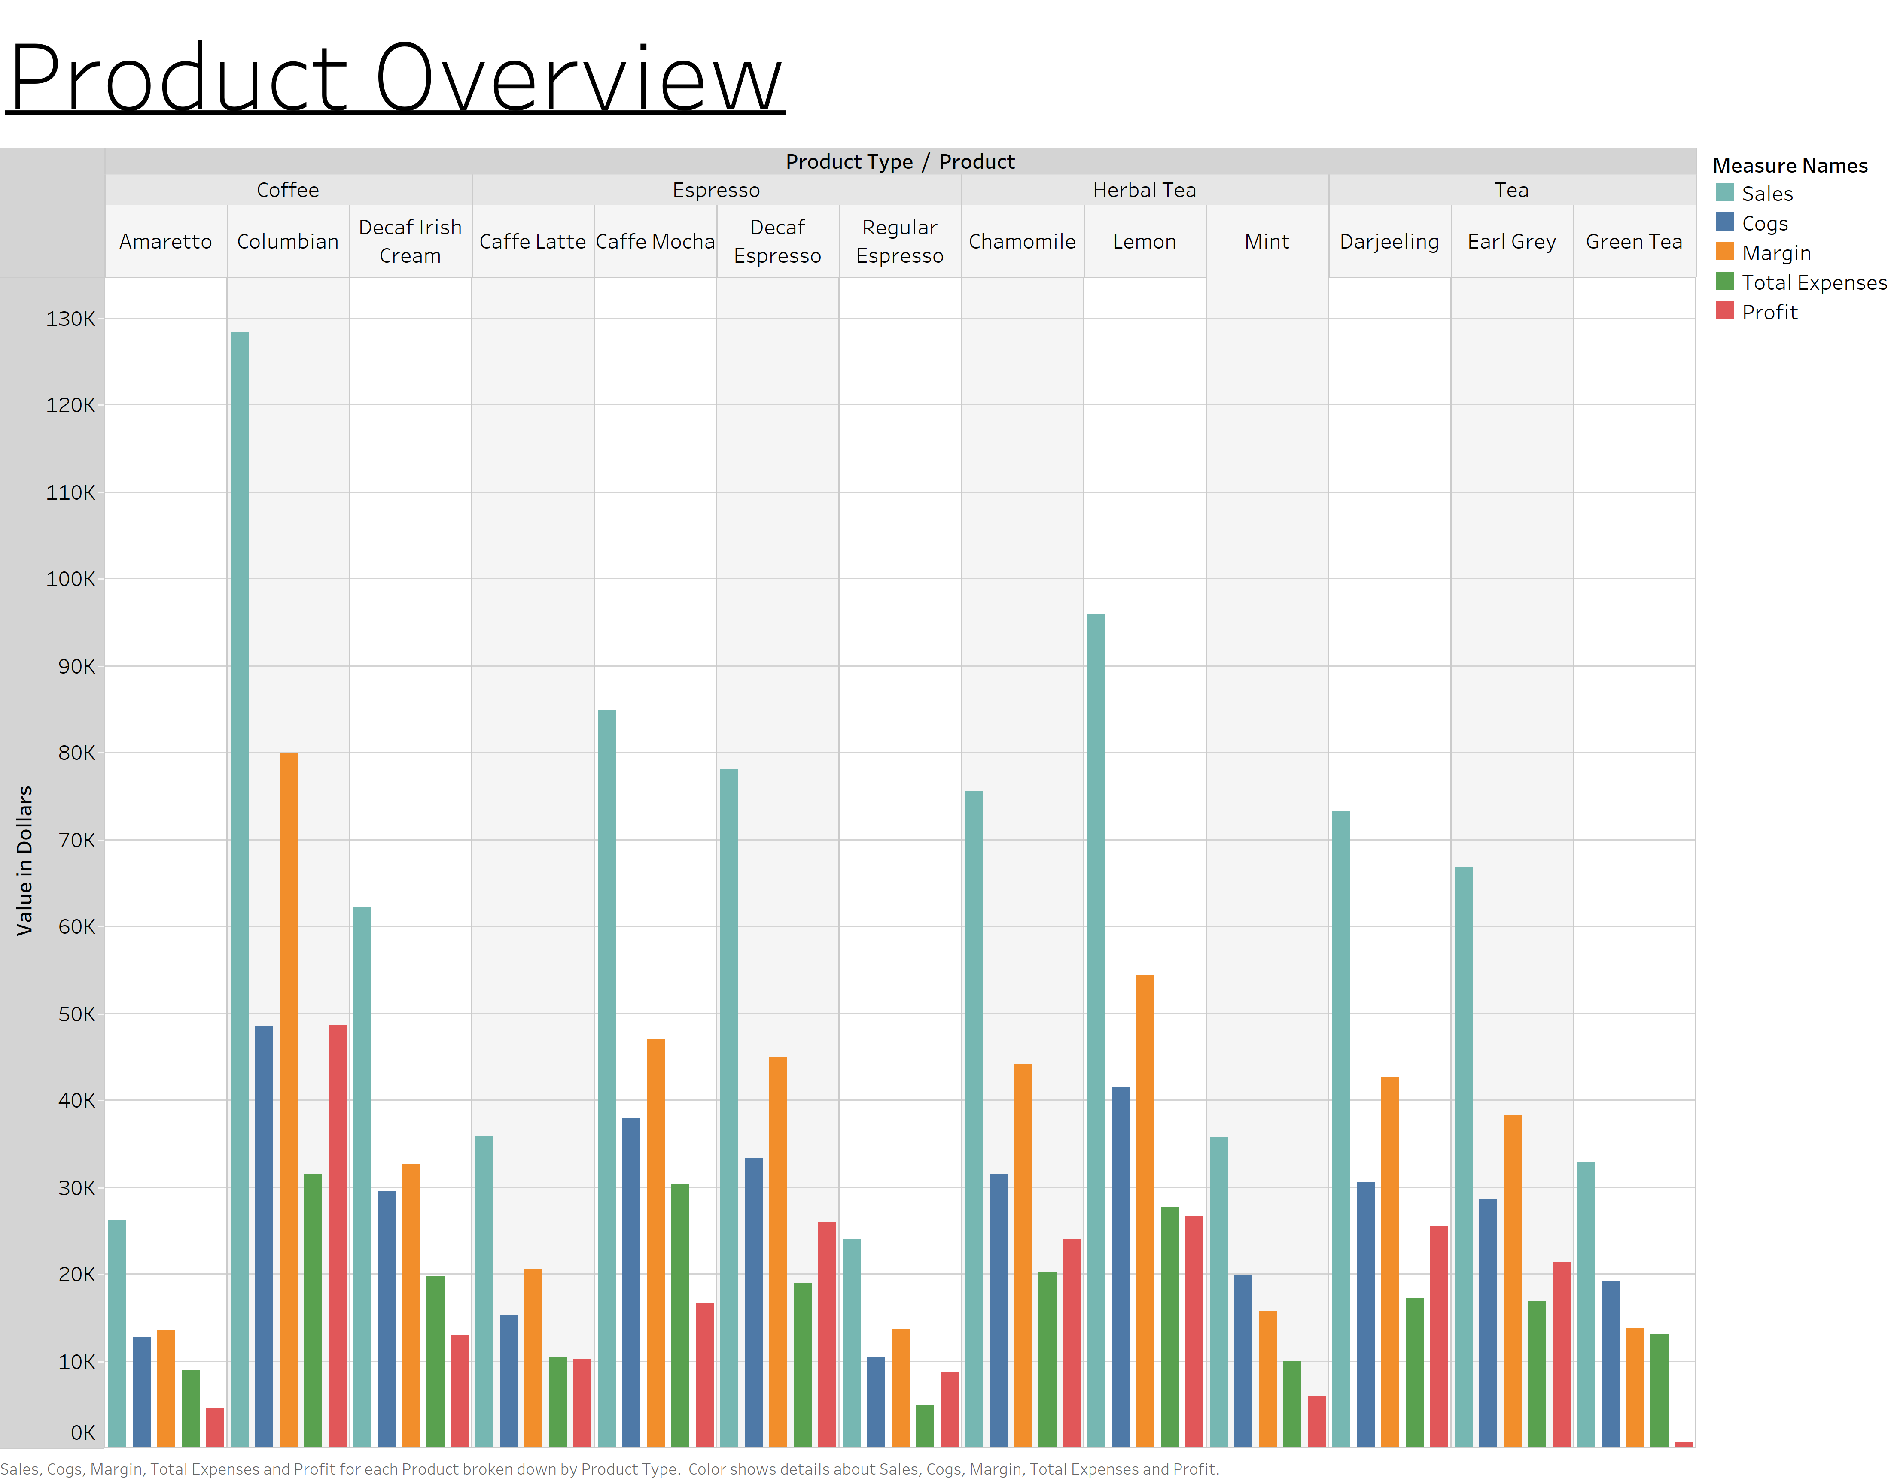

Slide 7
General Question
With a general overview of each products’ performance, an investigation began to better understand the worst performing products.
General Question: What are some of the products that have performed the worst and why?

Slide 8
Product Margins
Question: What kind of percentages can be calculated to get a better gauge on the performance of each product?
To understand the performance of each product even better, the gross margin and net profit percentages have been calculated. These percentages have been displayed for each product in a bar chart on the next slide.
Observation: Based on the following chart, it has become much easier to understand the broad overview of each product based on individual gross margin and net profit. The lowest performing products must now be identified and grouped together.

Slide 9
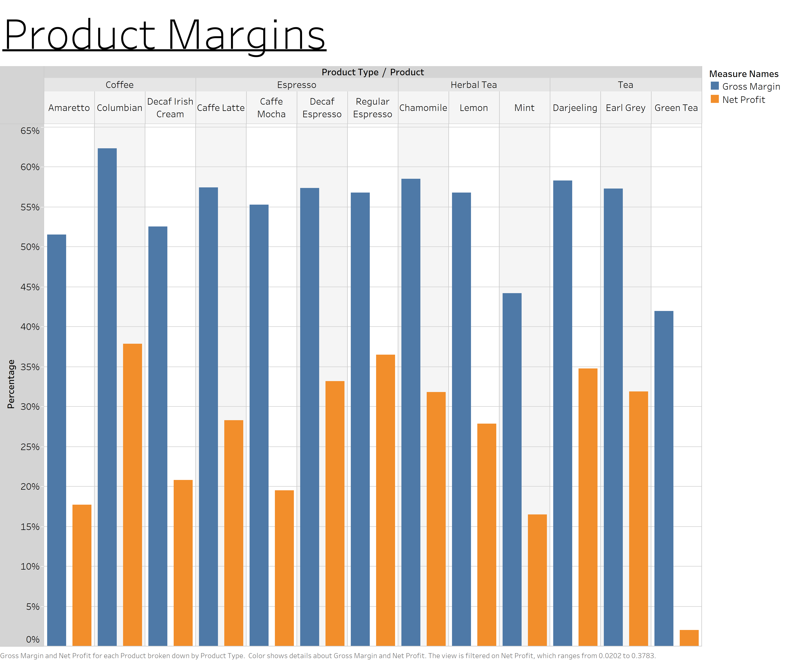

Slide 10
Product Margins
Question: How can the lowest performing products be easily identified and grouped together into a new bar chart?
Based on the table in the previous slide, a filter was used to display the products with a net profit under 20%. This new bar chart can be viewed on the next slide.
Observation: Based on the following chart, green tea appears to have the worst margins followed by Mint, Amaretto, and then Caffe Mocha. At this point, it is still unclear why these products have performed so poorly. There must be other factors that could explain this poor performance.

Slide 11
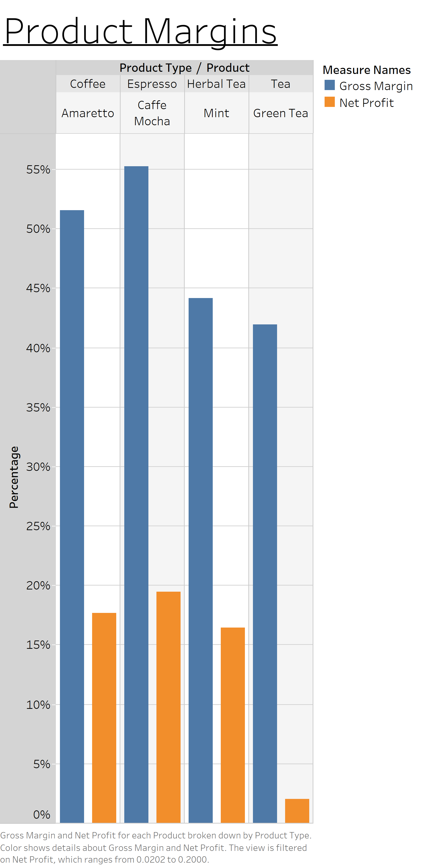

Slide 12
Margins - Product by State
Questions: How could the performance of each product be further examined? What is the performance of each product by state?
The gross margin and net profit percentage calculations from before were reused in a new table on the next slide to gauge product margins by state.
Observation: Based on the gross margins and net profits in the following table, Green Tea in Nevada, Mint and Caffe Mocha in New York, and Amaretto and Decaf Irish Cream in California have some of the lowest margins. There are other negative margins displayed, but they aren’t nearly as low. What this table reveals is that product margins can vary by state. The next step is to get a better view of these low performing products by state.

Slide 13
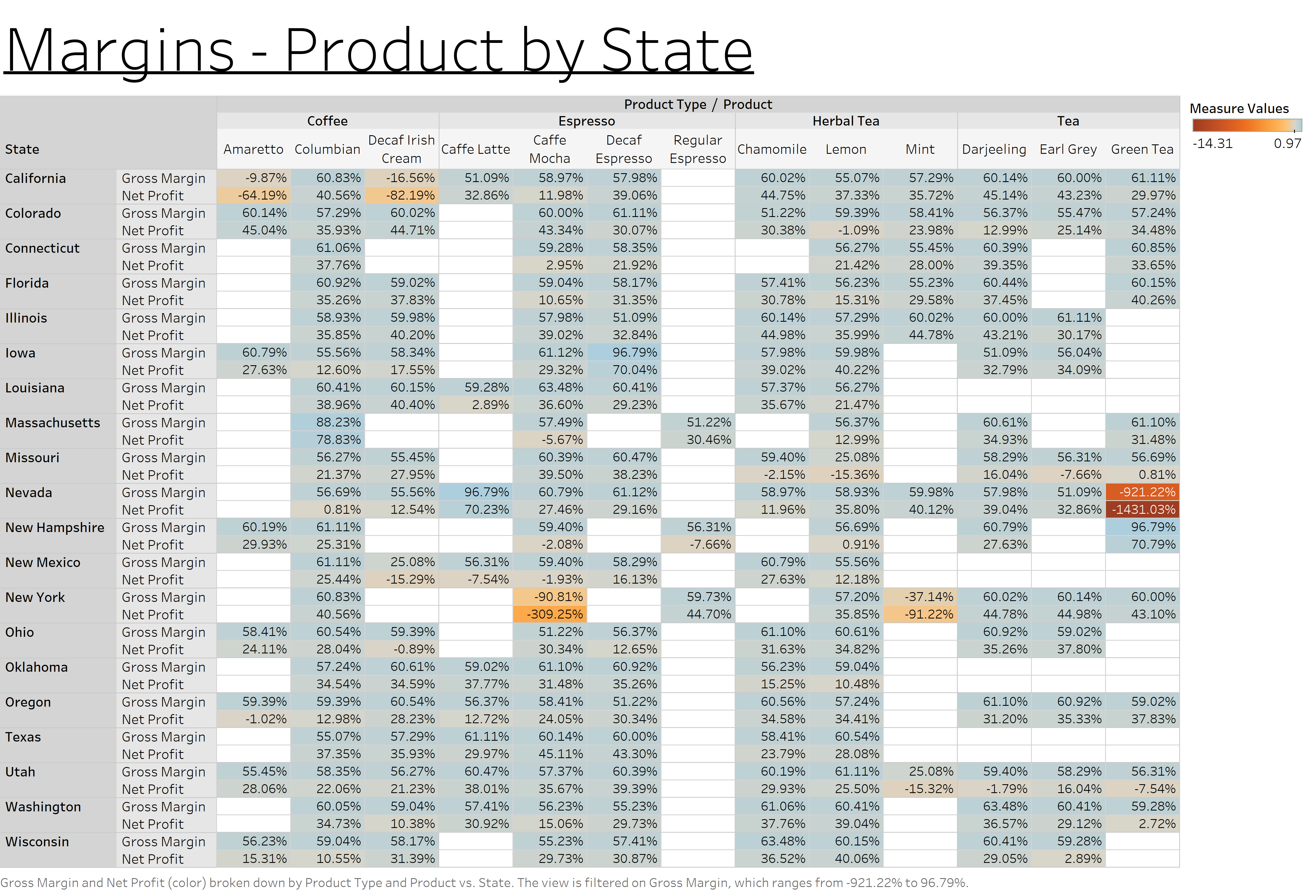

Slide 14
Margins - Product by State
Questions: How can the lowest margins for each product by state be displayed separately?
With the gross margin slider filter, the range has been adjusted to show the negative values up to and including 0%.
Observation: Based on the following table, it has become much easier to only visualize the lowest margin products by state. These are the same products that were previously mentioned. The next step was to discover any factors that could explain these negative margins.

Slide 15
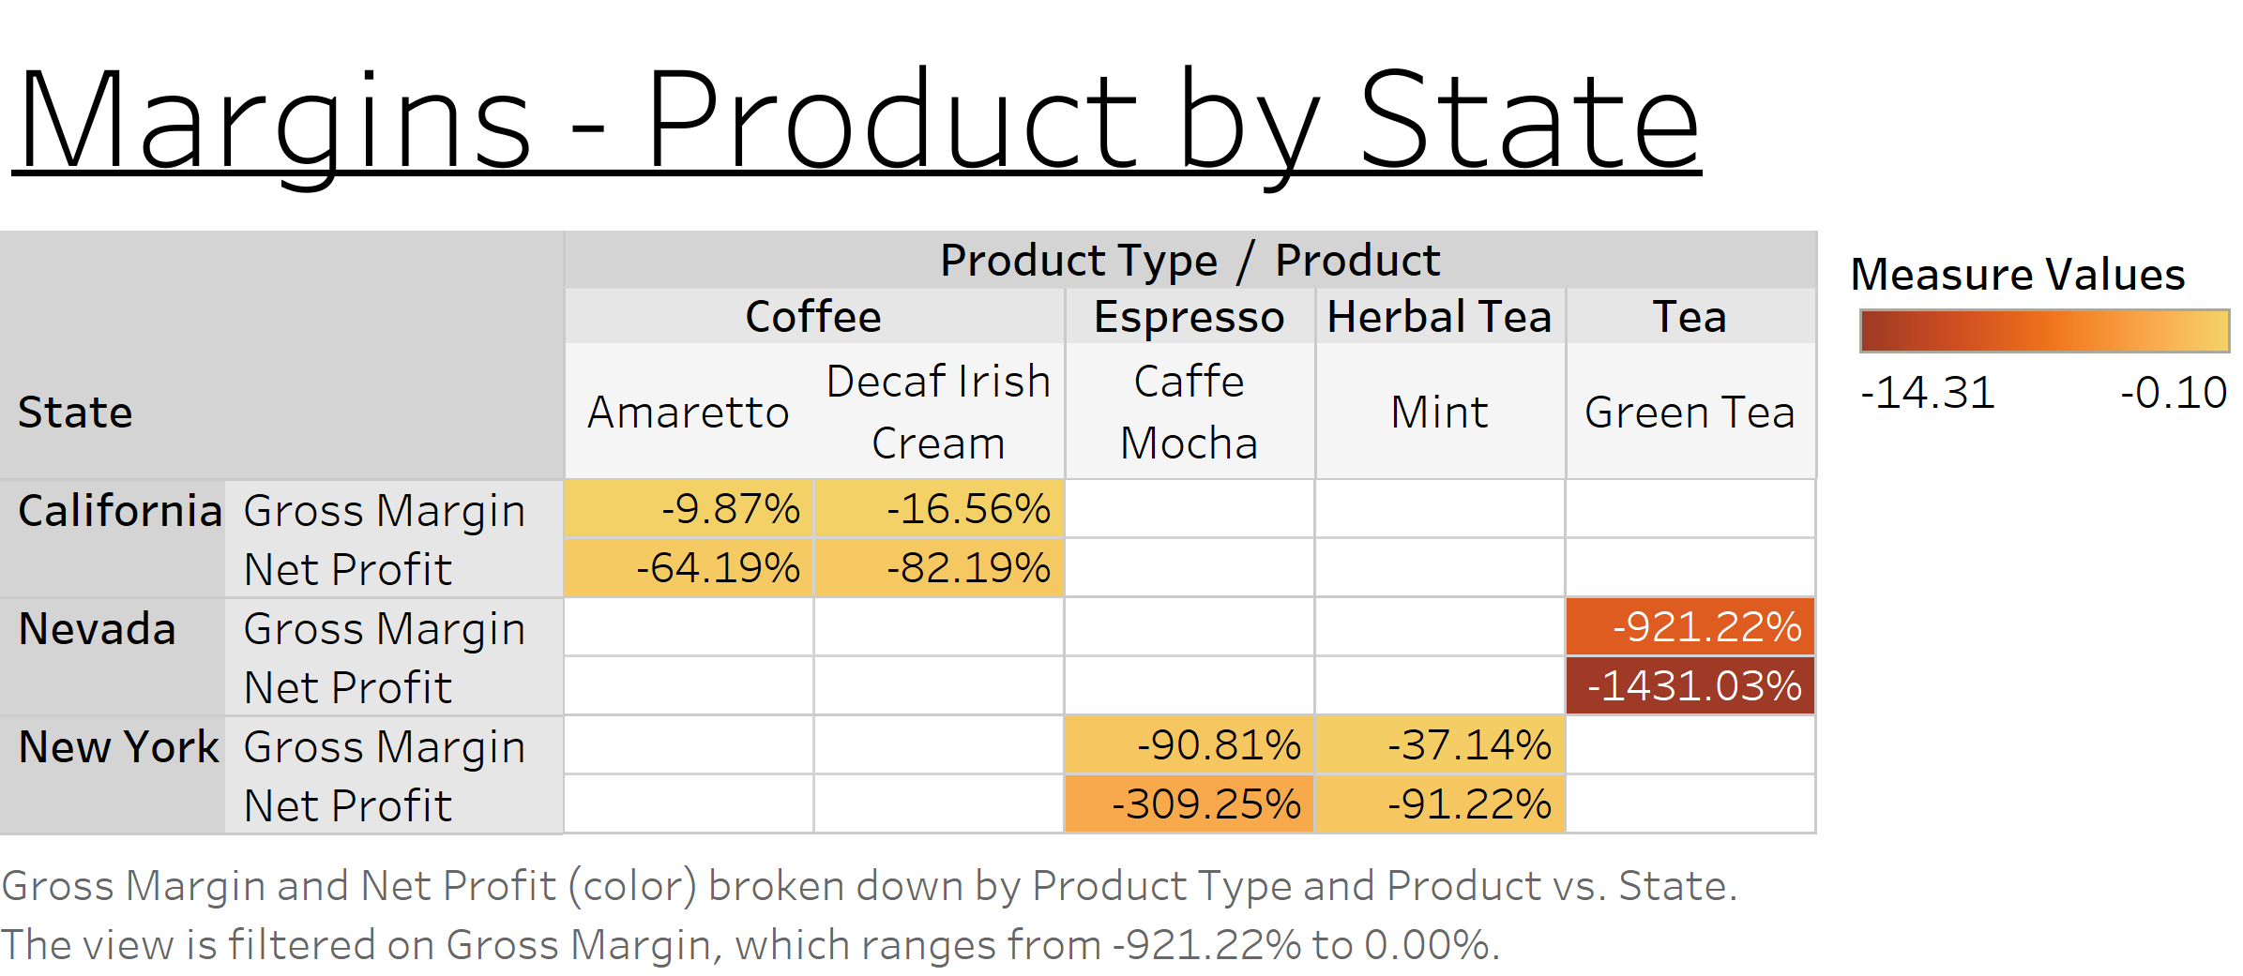

Slide 16
General Question
General Question: What are some potential factors that would lead to a negative gross margin or negative net profit?
Profitability for any product requires that sales exceed COGS, and margin exceed total expenses. What this suggests is that the negative margins from the previous slide do not follow this profitability rule. Those products by state must have COGS exceeding sales, and/or total expenses exceeding margin. This has led me to think about inventory and how it may be associated with these low margin products. Furthermore, the money spent on marketing each month is encompassed by total expenses for the corresponding month. The next step is to investigate inventory and determine if it relates to product performance.

Slide 17
Inventory – Product by State
Question: How can inventory be visualized to understand how it may relate to the low margin products by state?
A new chart has been created to visualize the level of inventory on hand each month for 2010 - 2011. The chart contains a single value “State” filter and a single value “Product” filter. This “Inventory – Product by State” chart and “Overview – Product by State” chart are displayed in the next five slides for each of the worst performing products by state. Each measure in the “Overview – Product by State” chart displays the corresponding summed value.
Observation: The next five slides show a very similar pattern in the data for the worst performing products by state. What can be seen is that the inventory on hand has continued to increase each month and then the pattern repeats itself in the following year. There are several issues with this pattern, and it appears to be associated with the lowest negative margin products. The inventory should go down over time and be replenished when it gets low. It appears that the increasing supply of inventory has outpaced the demand and has resulted in lower sales and negative margins. The next step is to do the same thing with the products by state with the highest margins.

Slide 18
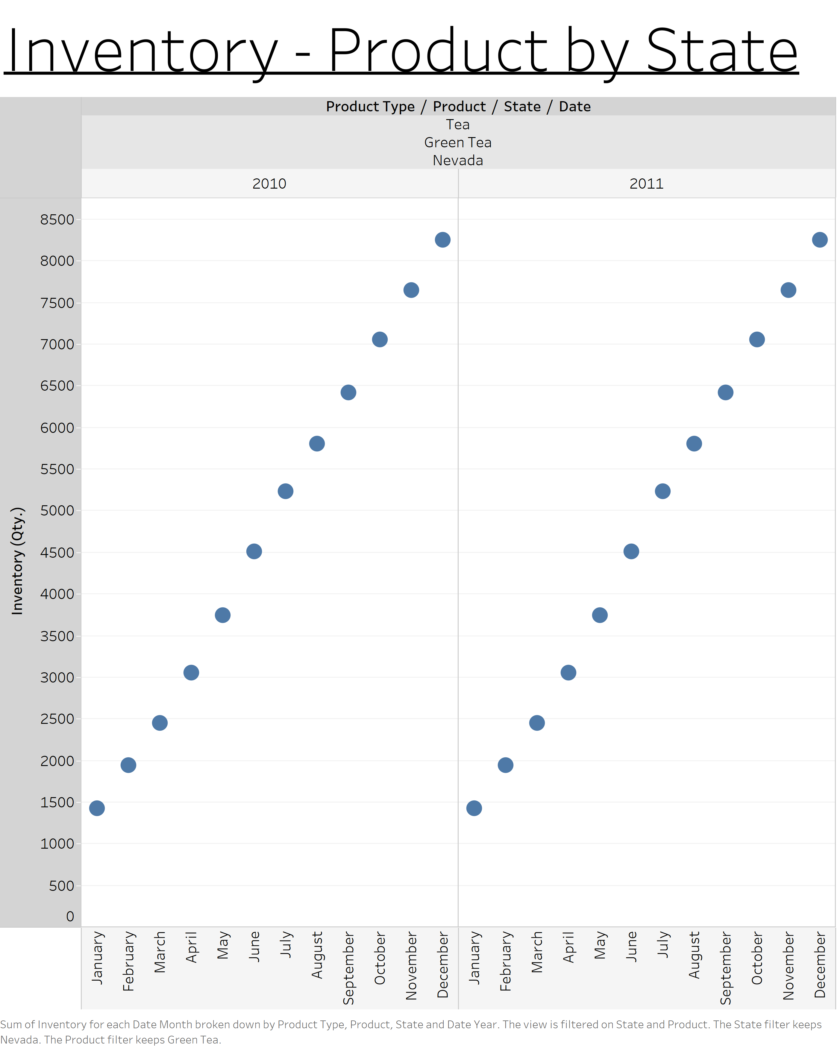
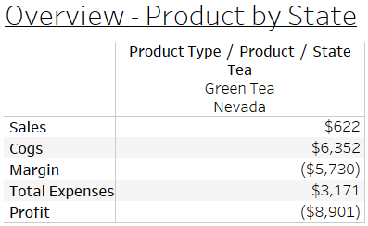
Green Tea | Nevada

Slide 19
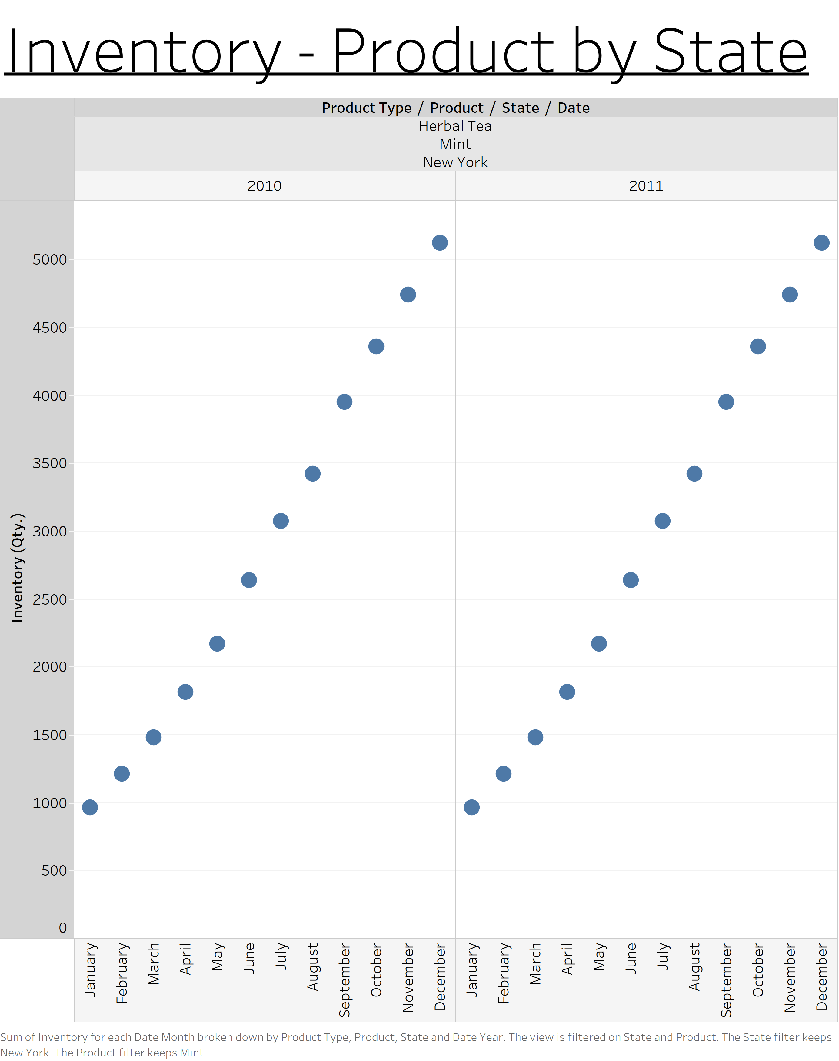
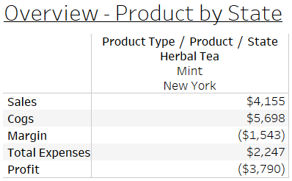
Mint | New York

Slide 20
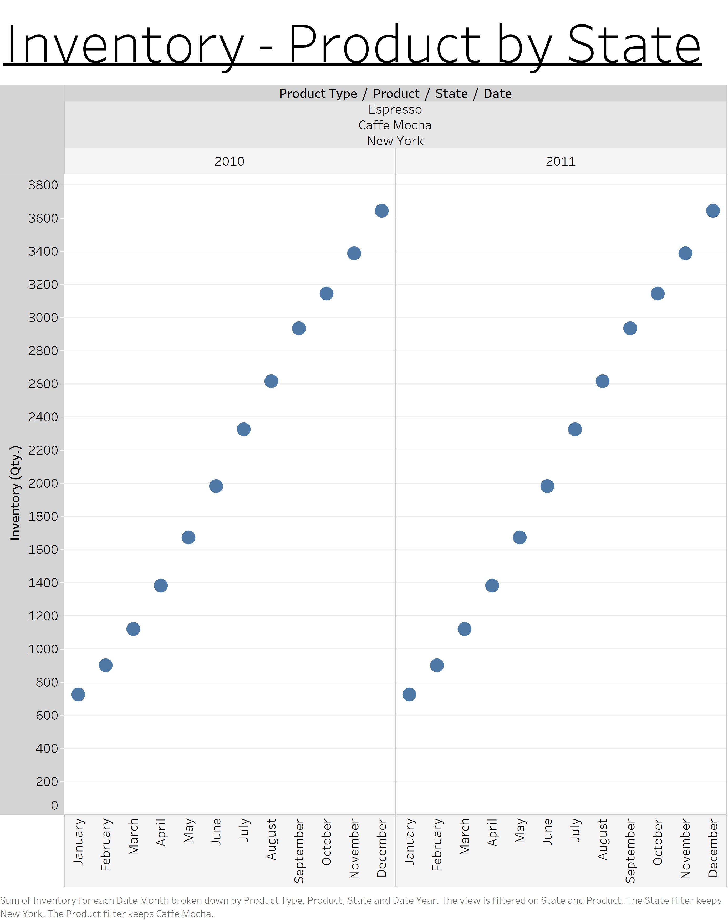
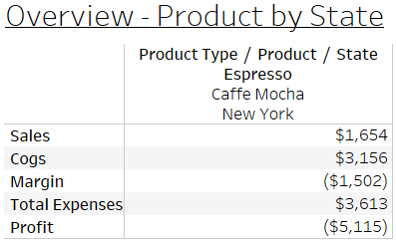
Caffe Mocha | New York

Slide 21

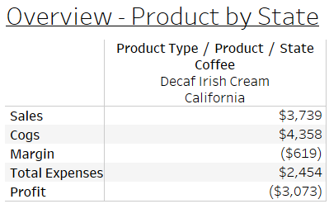
Decaf Irish Cream | California

Slide 22

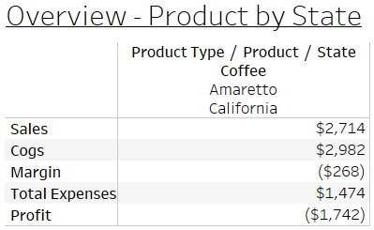
Amaretto | California

Slide 23
Inventory – Product by State
Question: What are some of the most profitable products by state?
Now that a repeatable pattern in the inventory for those products have been identified, maybe there is a pattern in the inventory for the most profitable products by state. The next slide contains a table with the highest margins for products by state.
Observation: The next slide shows the three most profitable products by state. The next step is to look for patterns in the inventory data based on these products. Once this is completed, the inventory charts for the negative and positive margin products can be compared.

Slide 24
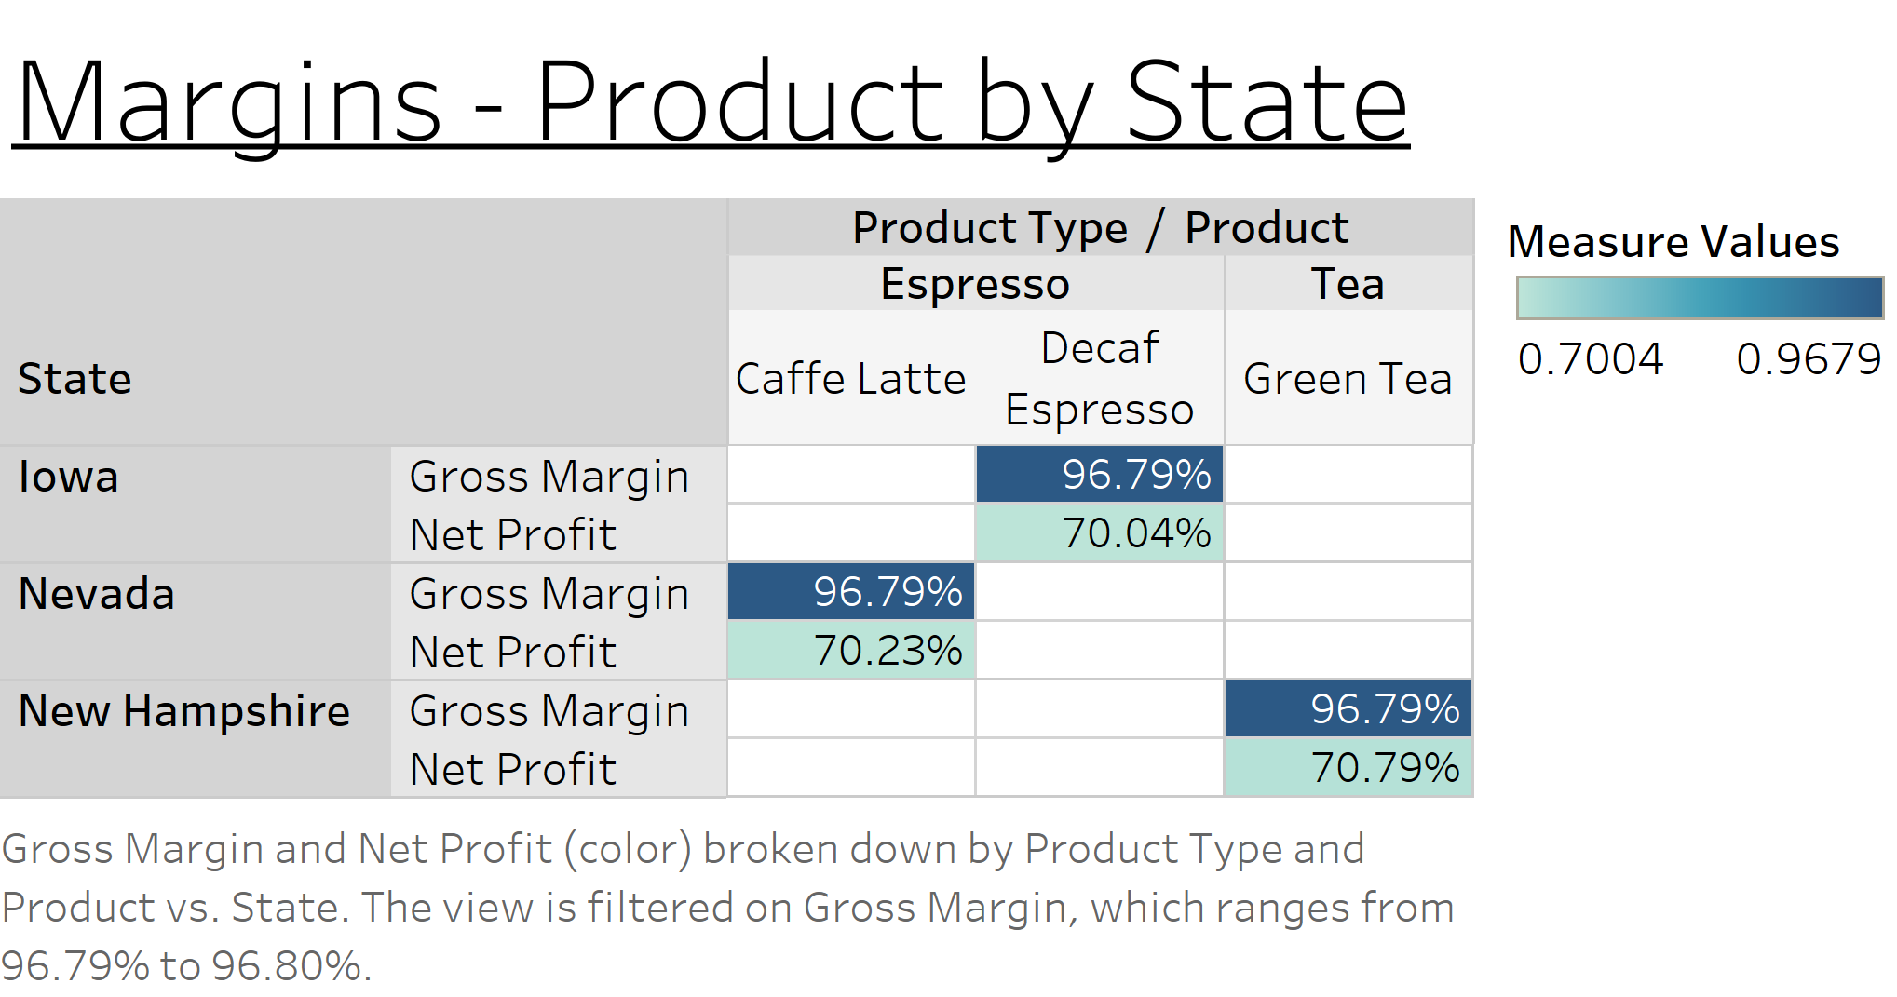

Slide 25
Inventory – Product by State
Question: What does the “Inventory – Product by State” chart look like for these high margin products by state?
Observation: The high margins of these products appear to be associated with a downward pattern in inventory over time. The COGS are very low, and the inventory appears to be decreasing at a healthy pace which explains the high sales numbers. One problem with these charts is that the inventory is not being used to its full potential. If the assumption is that this inventory pattern will remain the same each year, then the quantity acquired at the beginning of each year could be lowered to approximately 500. This could potentially result in less wasted inventory and even higher margins. Another potential issue here is that these three products have very similar numbers to one another and their “Inventory – Product by State” charts are exactly the same. This could be a coincidence or maybe the values in the data file for these products have been entered incorrectly.

Slide 26
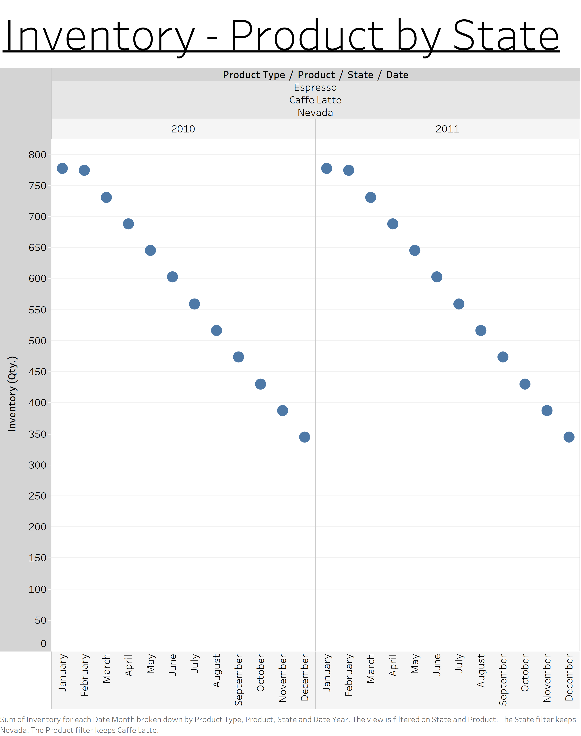
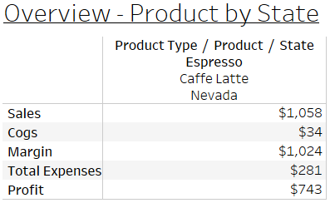
Caffe Latte | Nevada

Slide 27
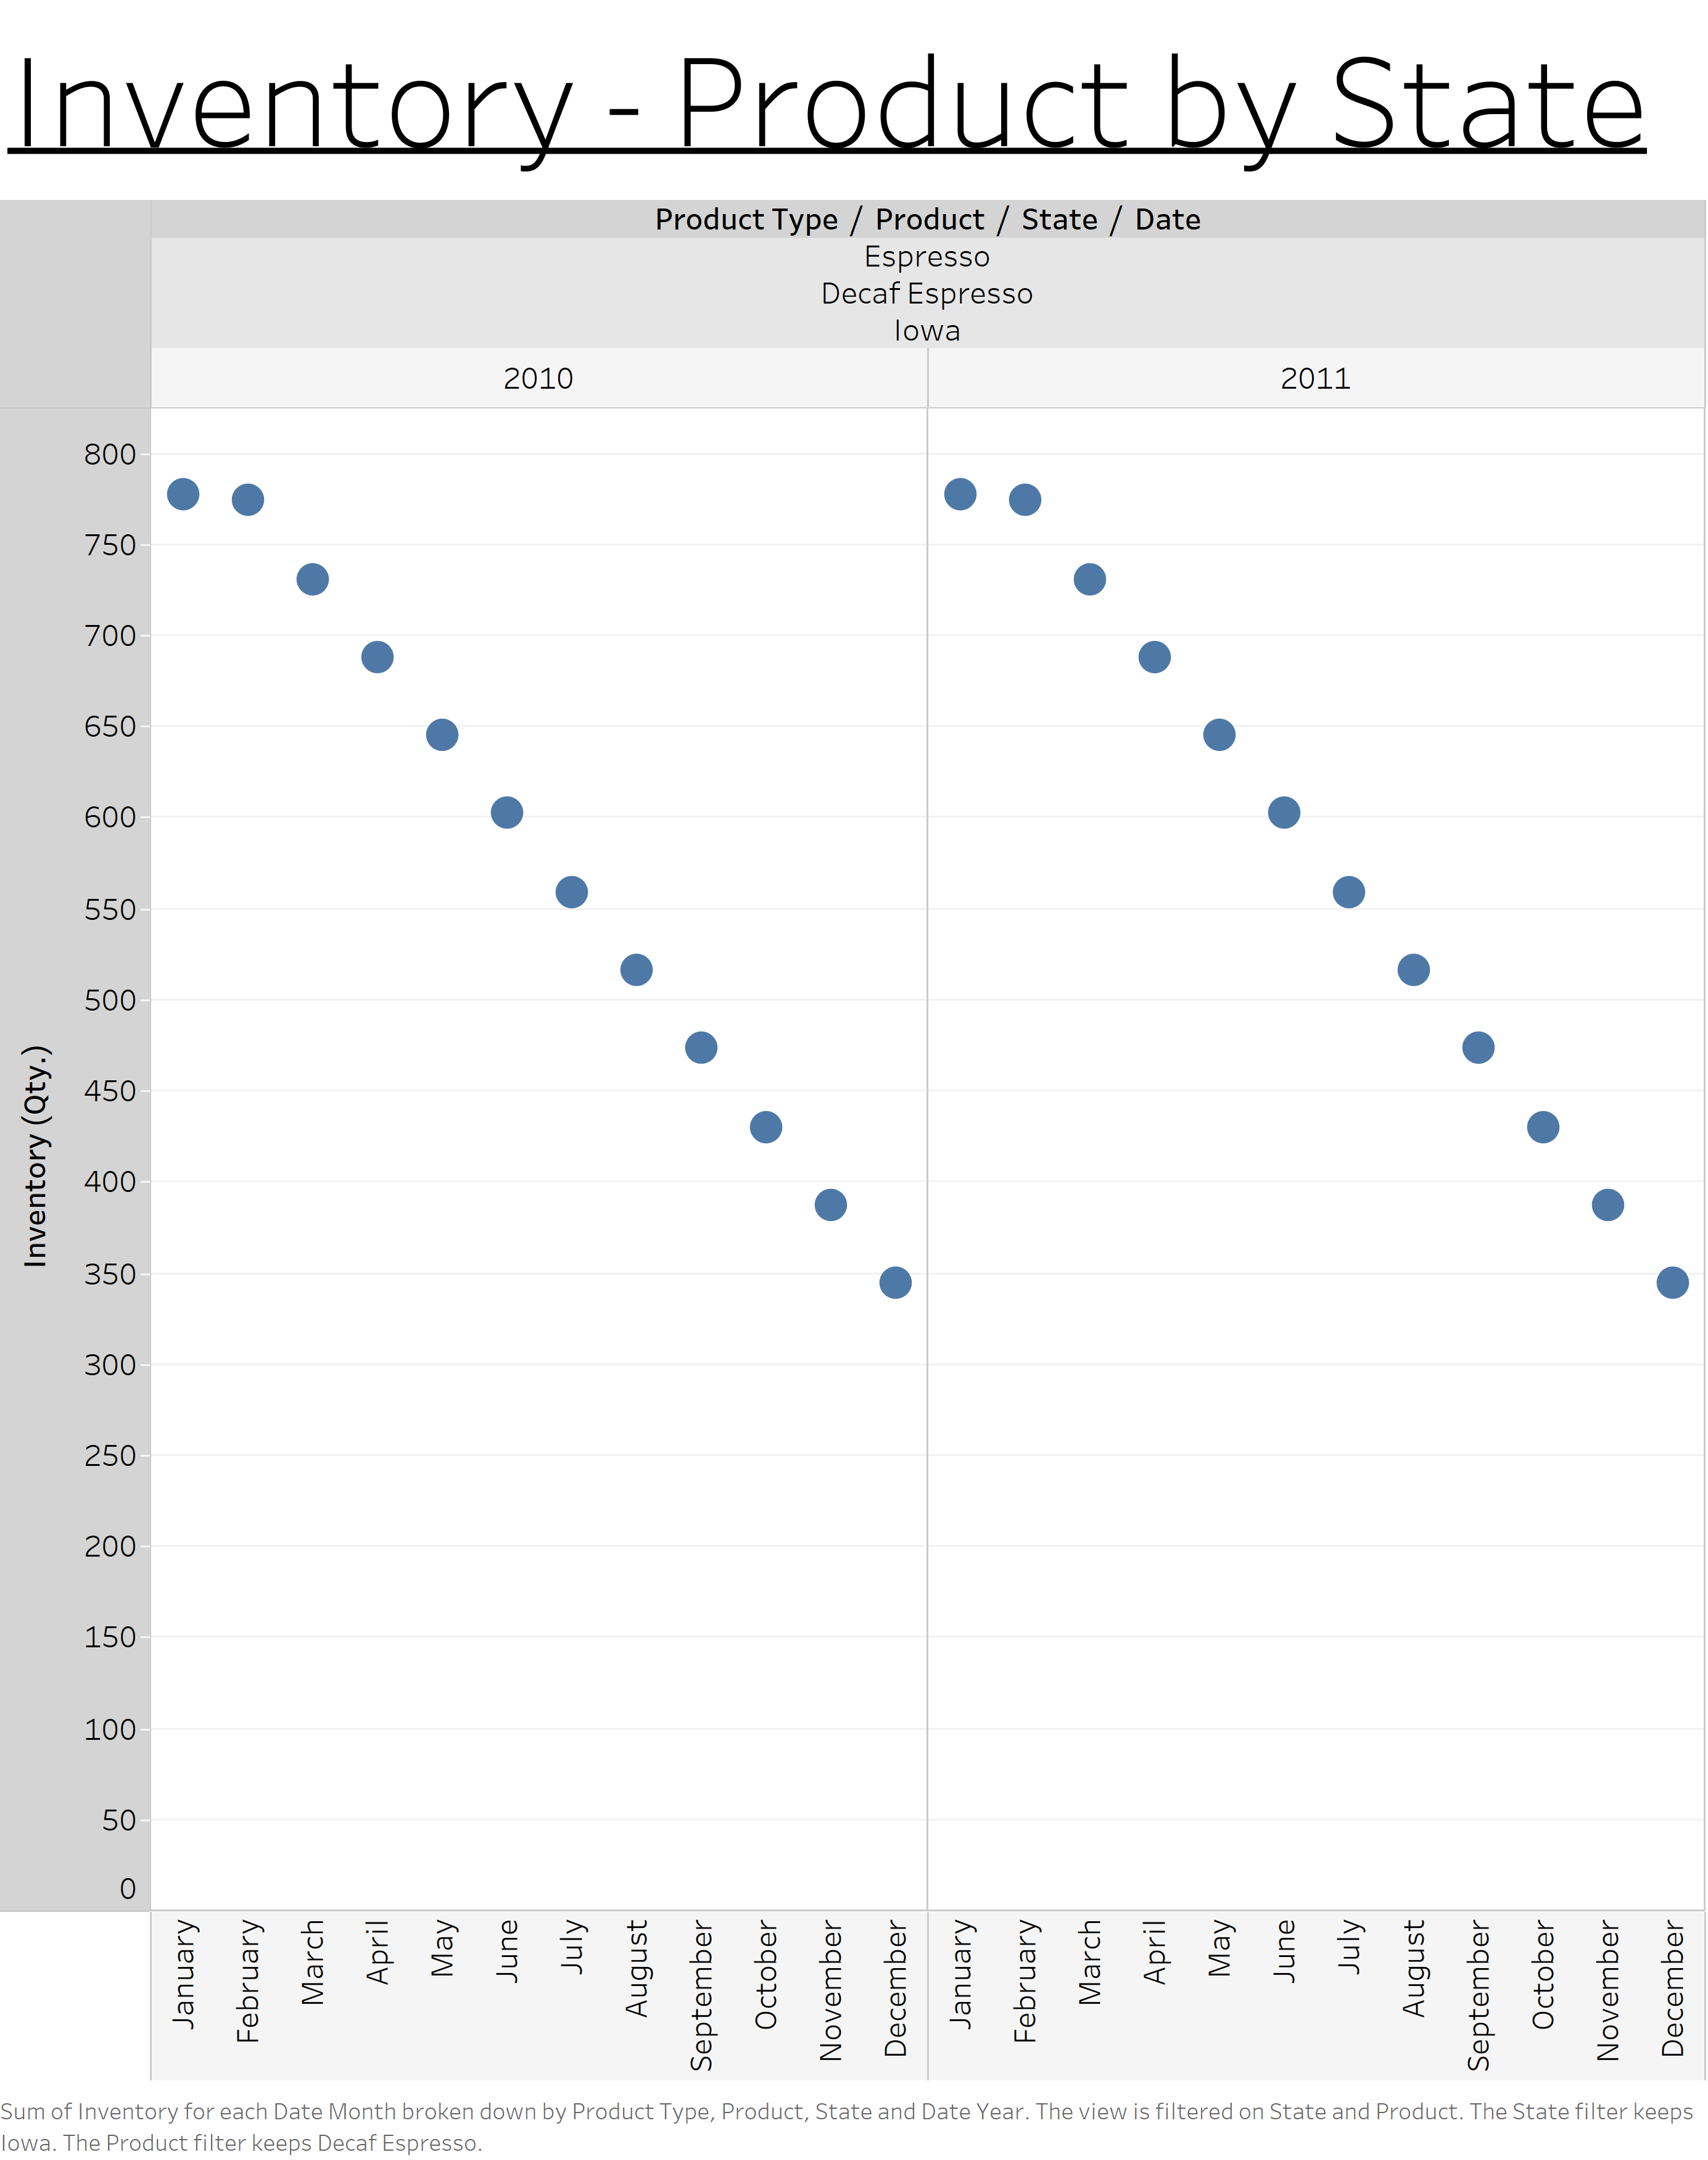
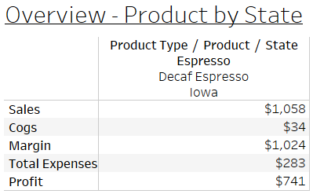
Decaf Espresso | Iowa

Slide 28

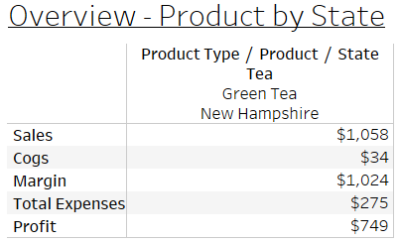
Green Tea | New Hampshire

Slide 29
Issue 1
The first issue that impacts profitability relates to the inventory levels on hand over time for products by state. The products with the lowest profitability are associated with inventory levels that continue to increase over time. The products with the highest profitability are associated with inventory levels that continue to decrease over time.

Slide 30
Marketing – Product by State
Question: How does the amount of money spent on marketing impact the products by state with the lowest margins?
The following slides are similar to the “Inventory – Product by State” charts shown before. That chart was duplicated as a new worksheet and modified to show the marketing spend relative to the total expenses for a given month over time for the selected product and state.
Observation: The following five slides show the marketing spend relative to the total expenses over time for the same five lowest margin products by state. The pattern in these charts shows that the marketing spend is less than and follows a similar pattern to the total expenses. The next step is to observe the marketing spend for the highest margin products by state.

Slide 31
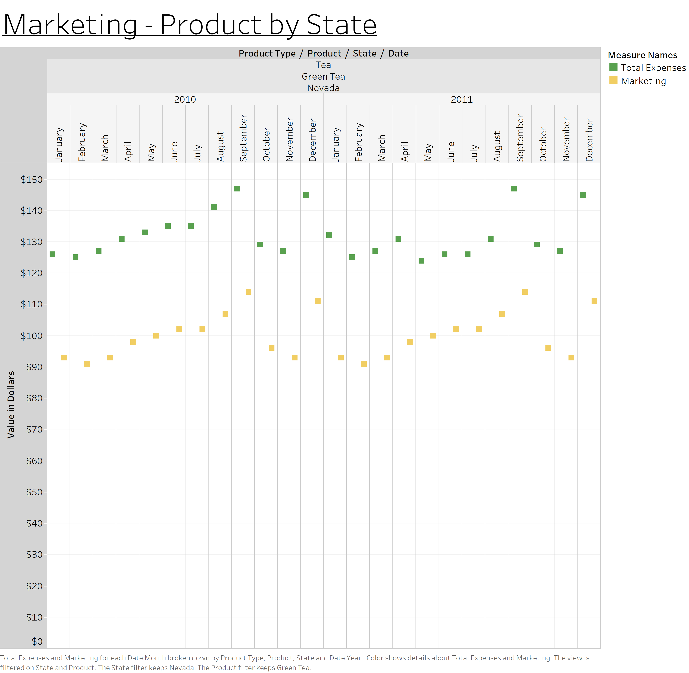
Green Tea | Nevada

Slide 32
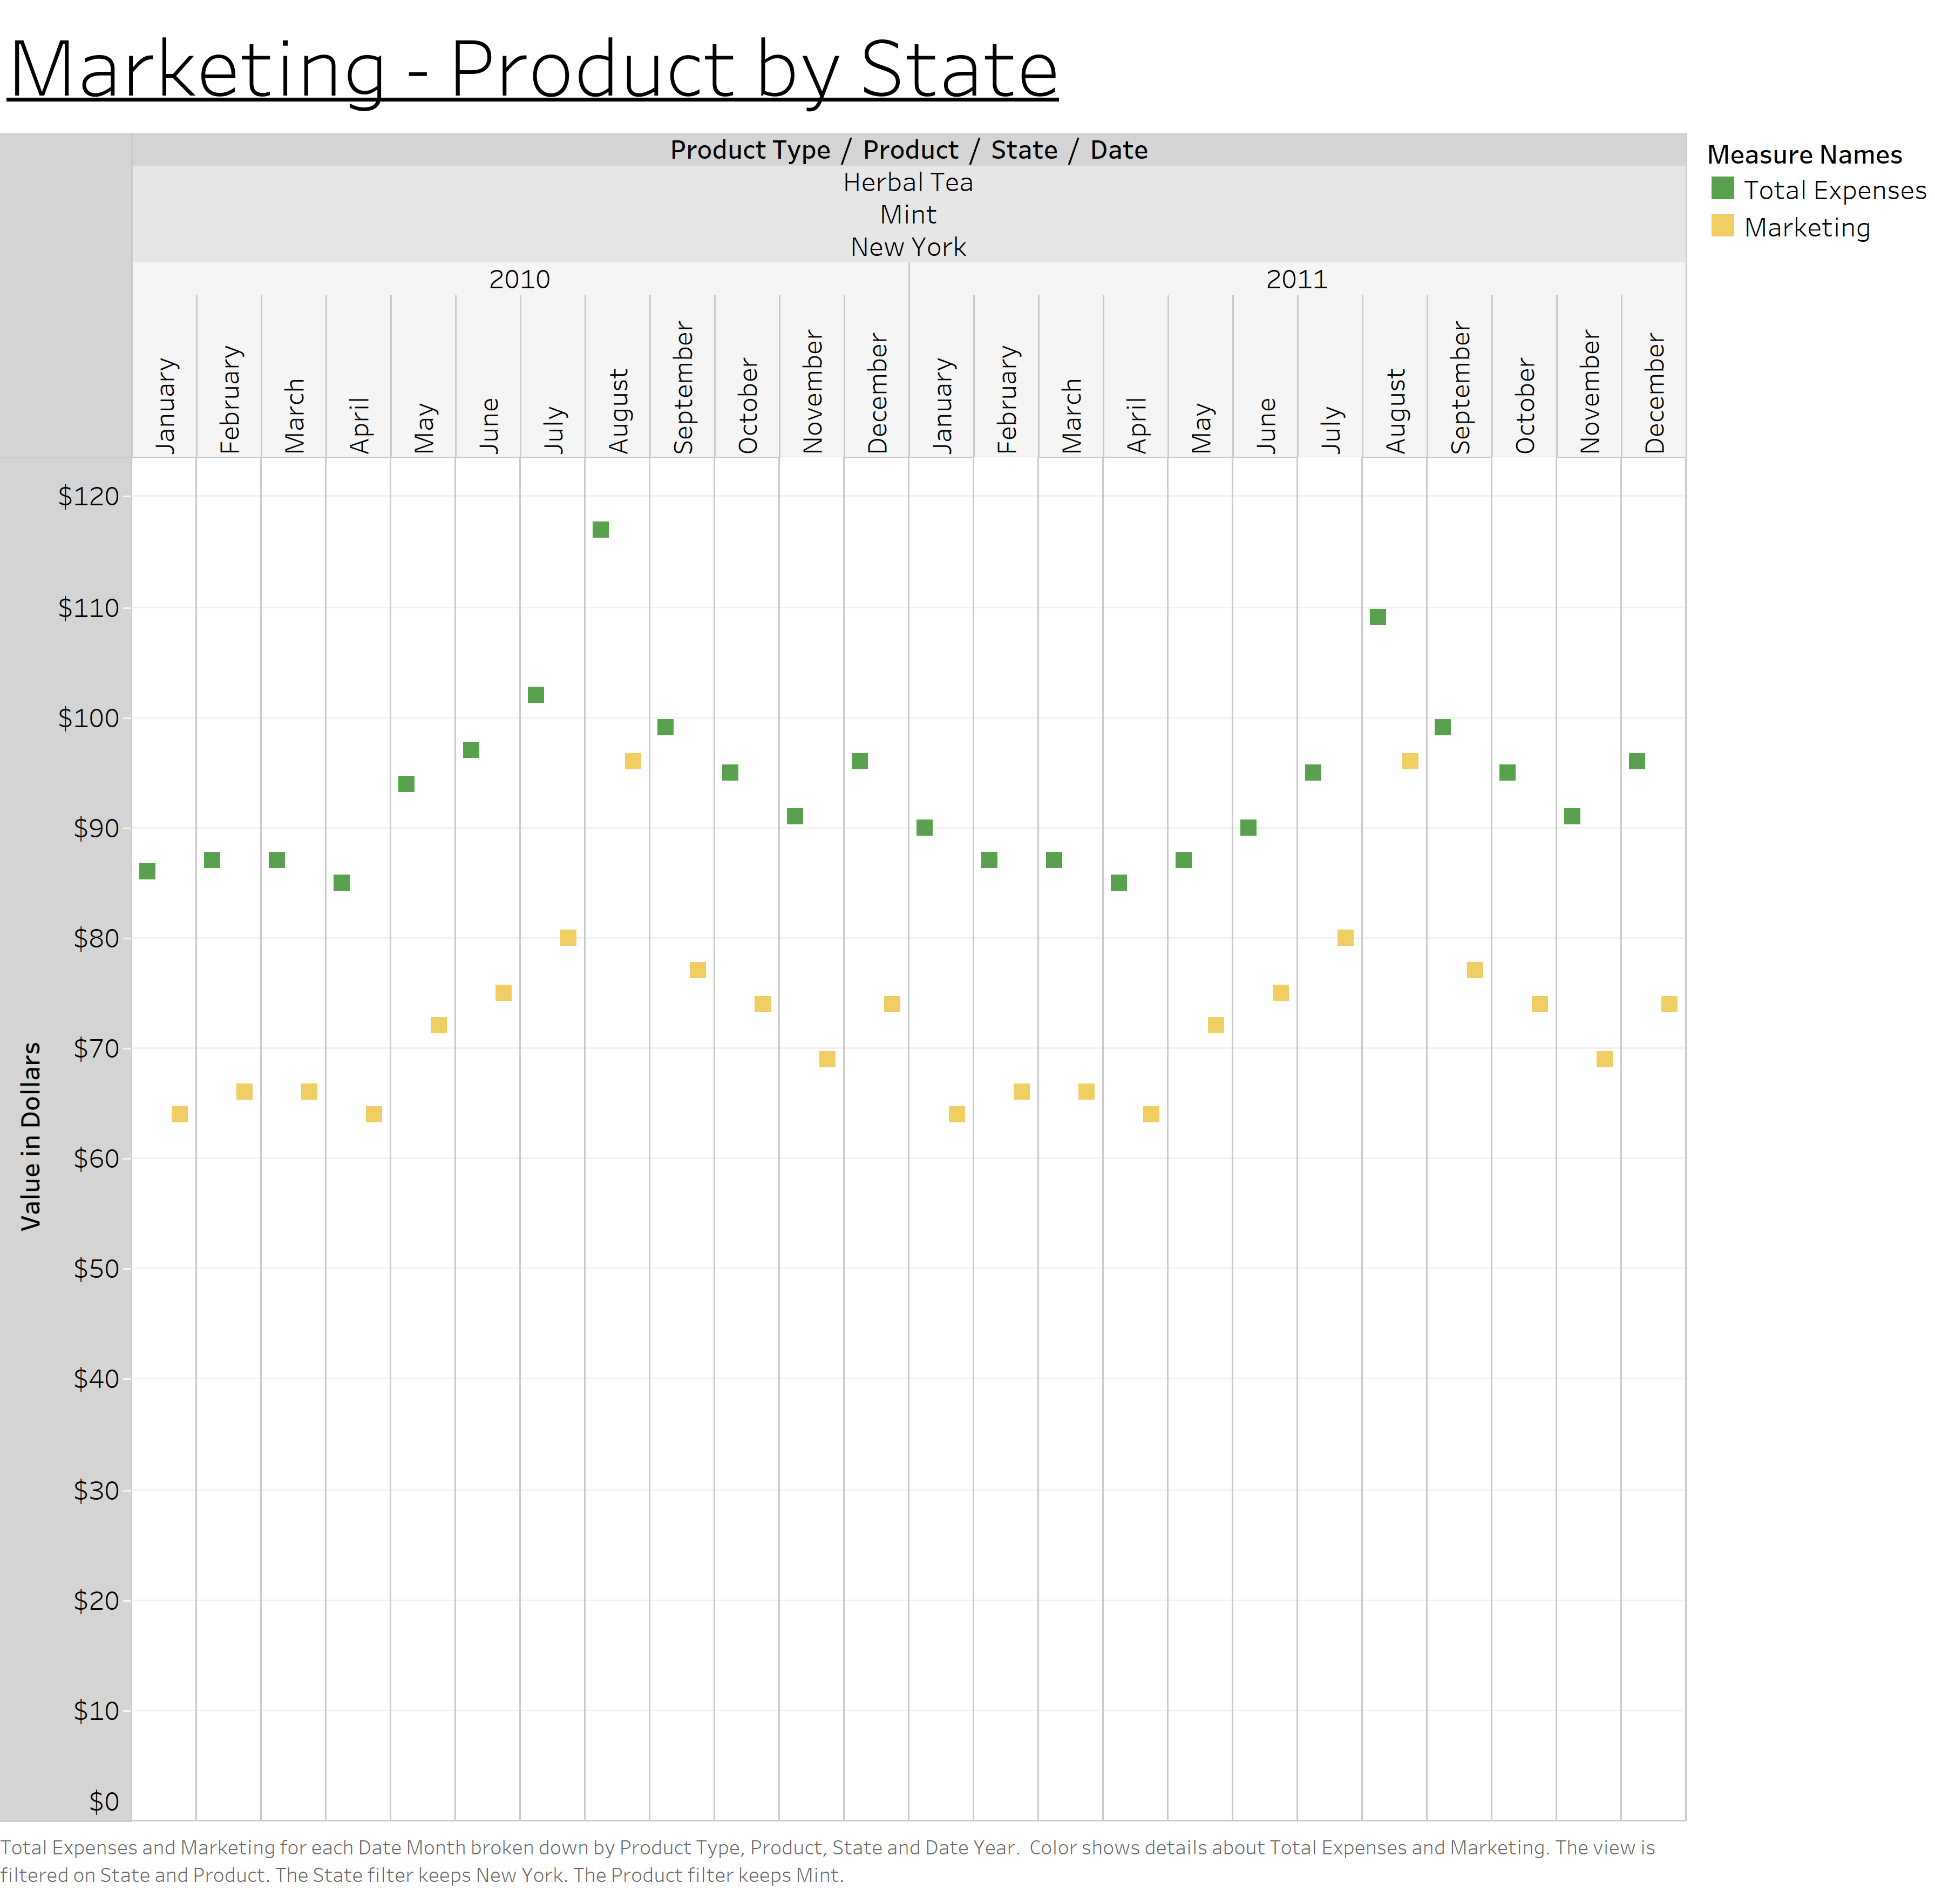
Mint | New York

Slide 33
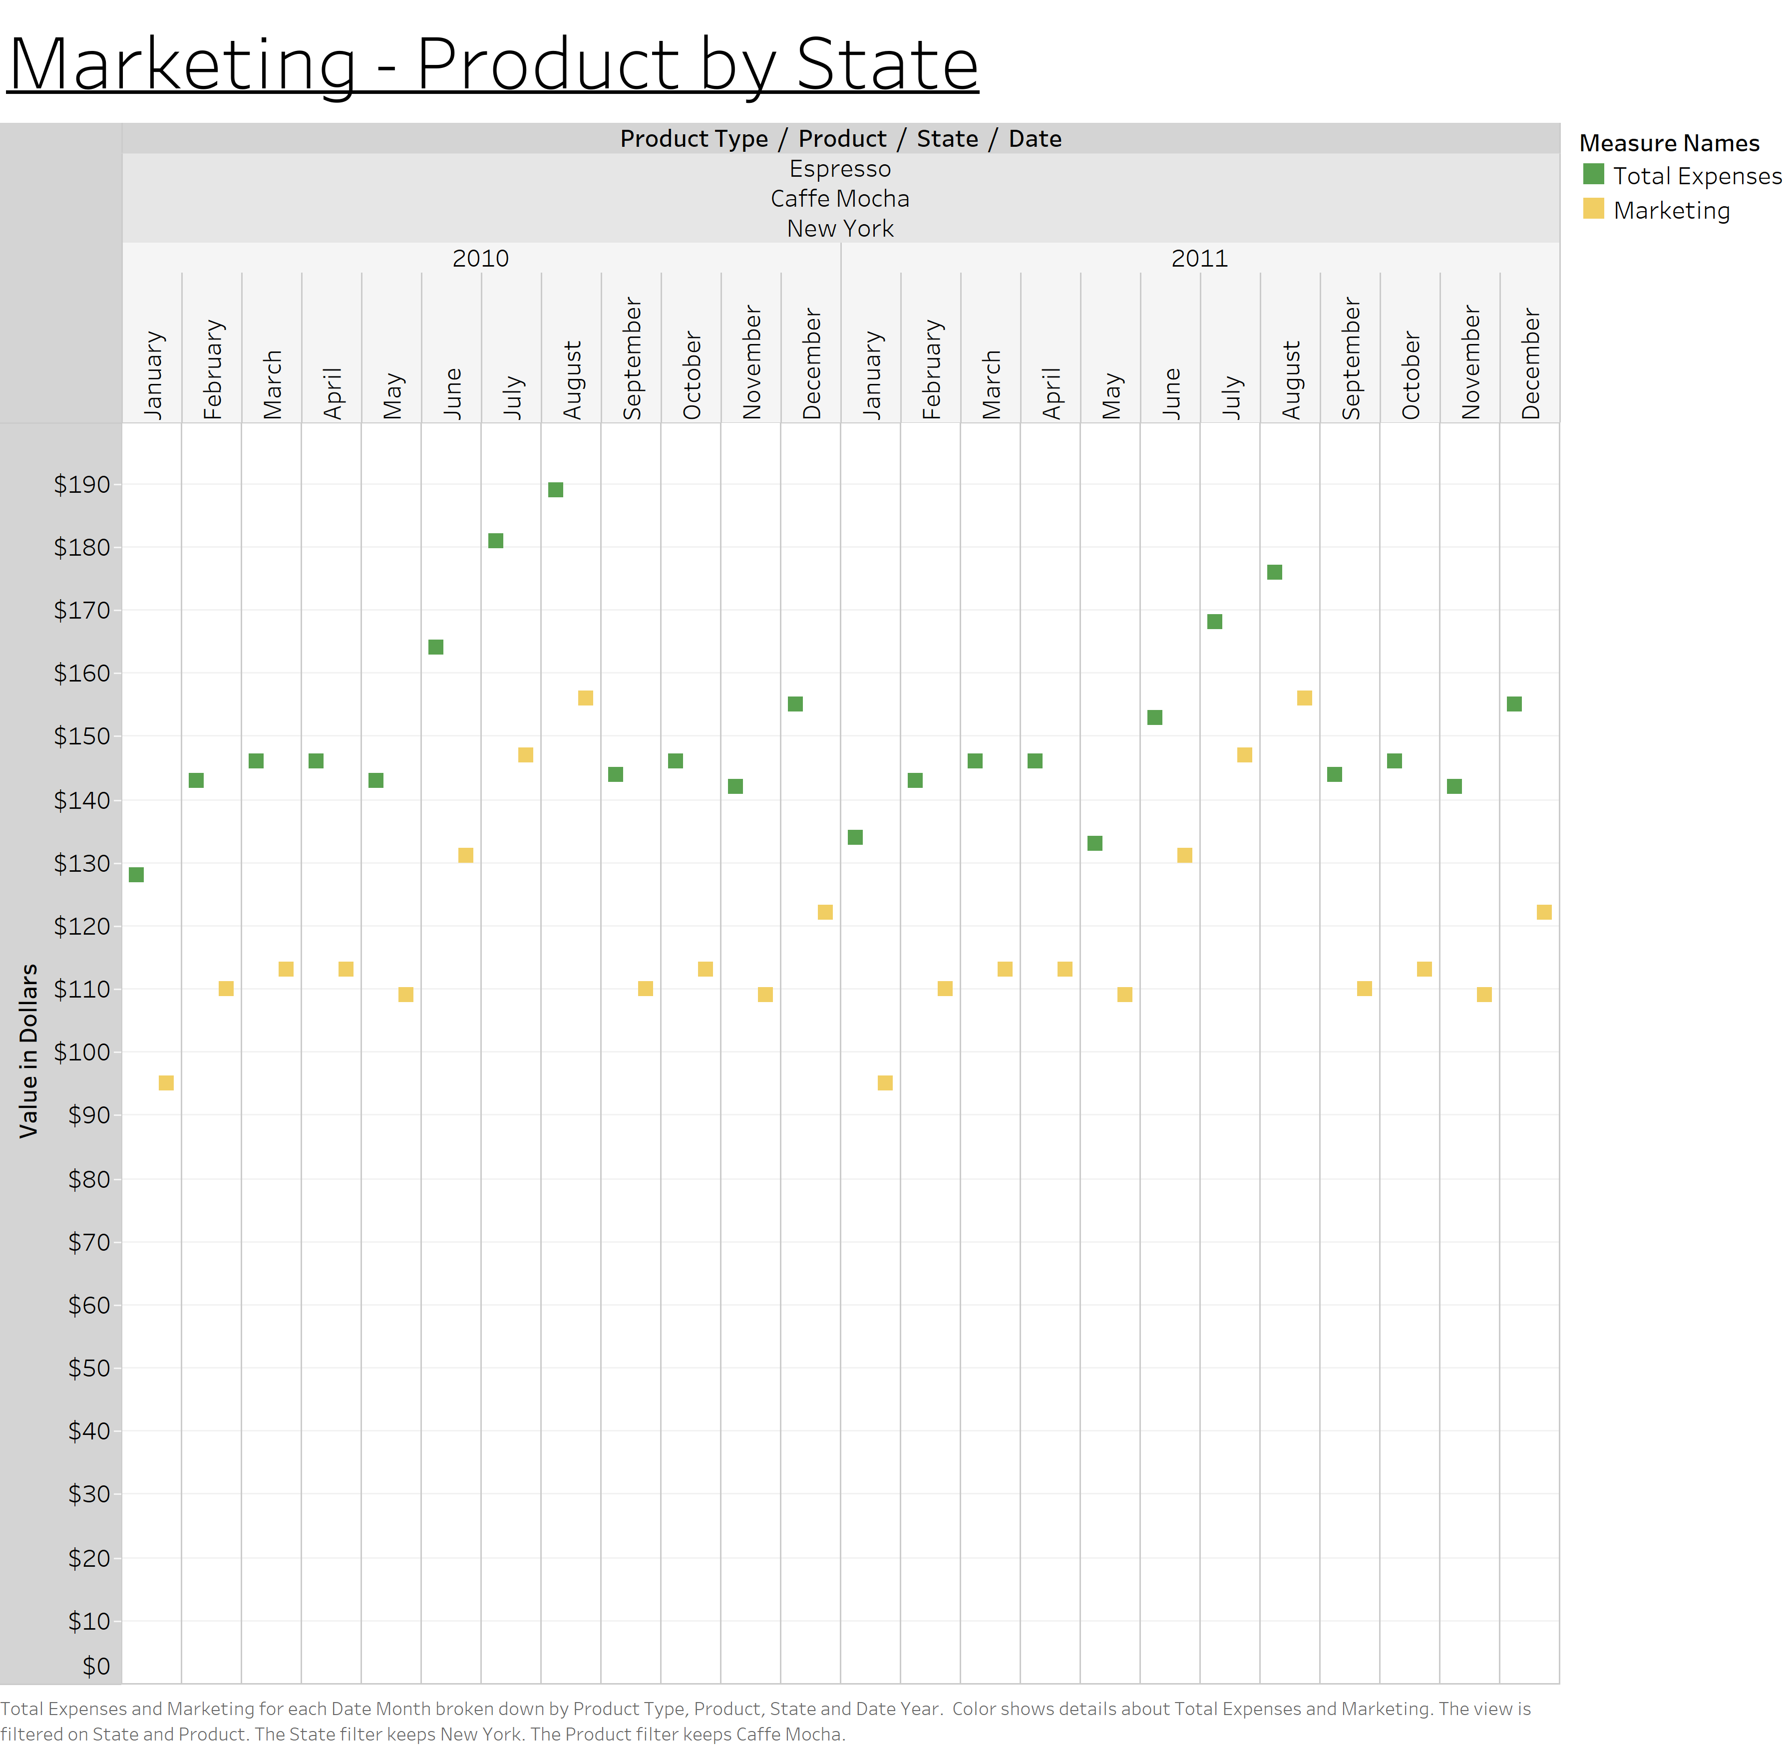
Caffe Mocha | New York

Slide 34
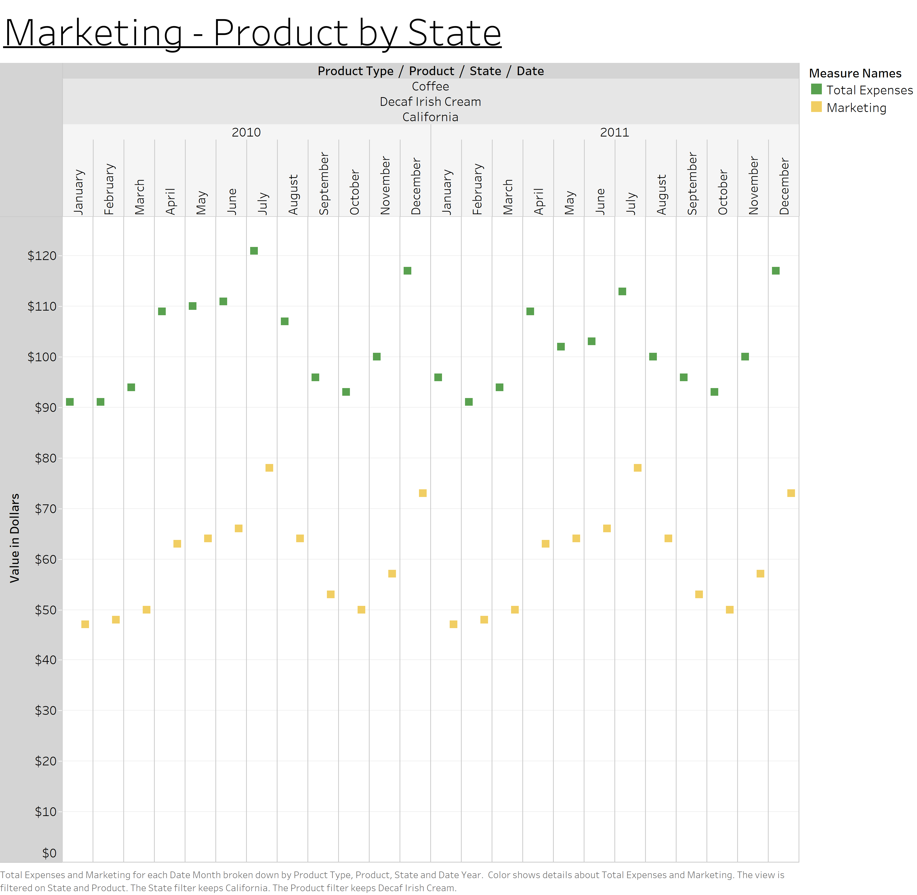
Decaf Irish Cream | California

Slide 35
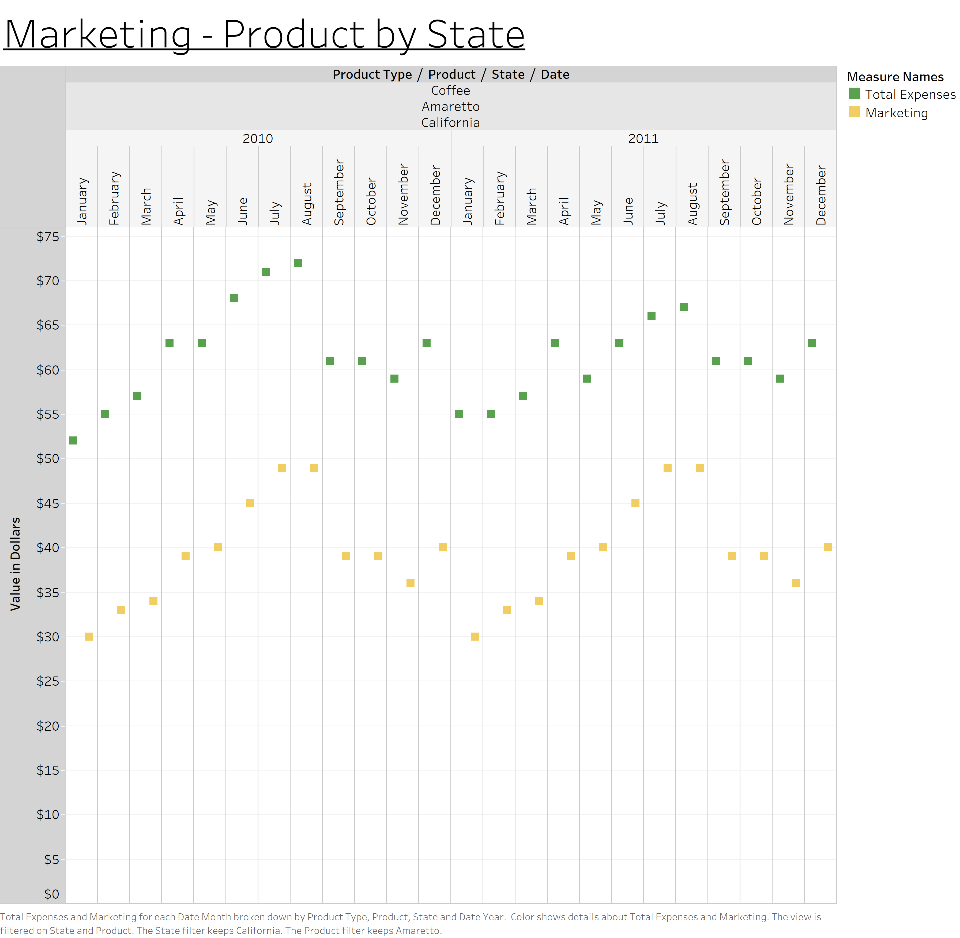
Amaretto | California

Slide 36
Marketing – Product by State
Question: How does the amount of money spent on marketing impact the highest margin products by state?
Observation: The following three slides show the marketing spend relative to the total expenses over time for the same three highest margin products by state. The patterns in the following charts show that the marketing spend is zero the whole year except for January. The total expenses and marketing spend are much lower for the high margin products compared to the low margin products.

Slide 37
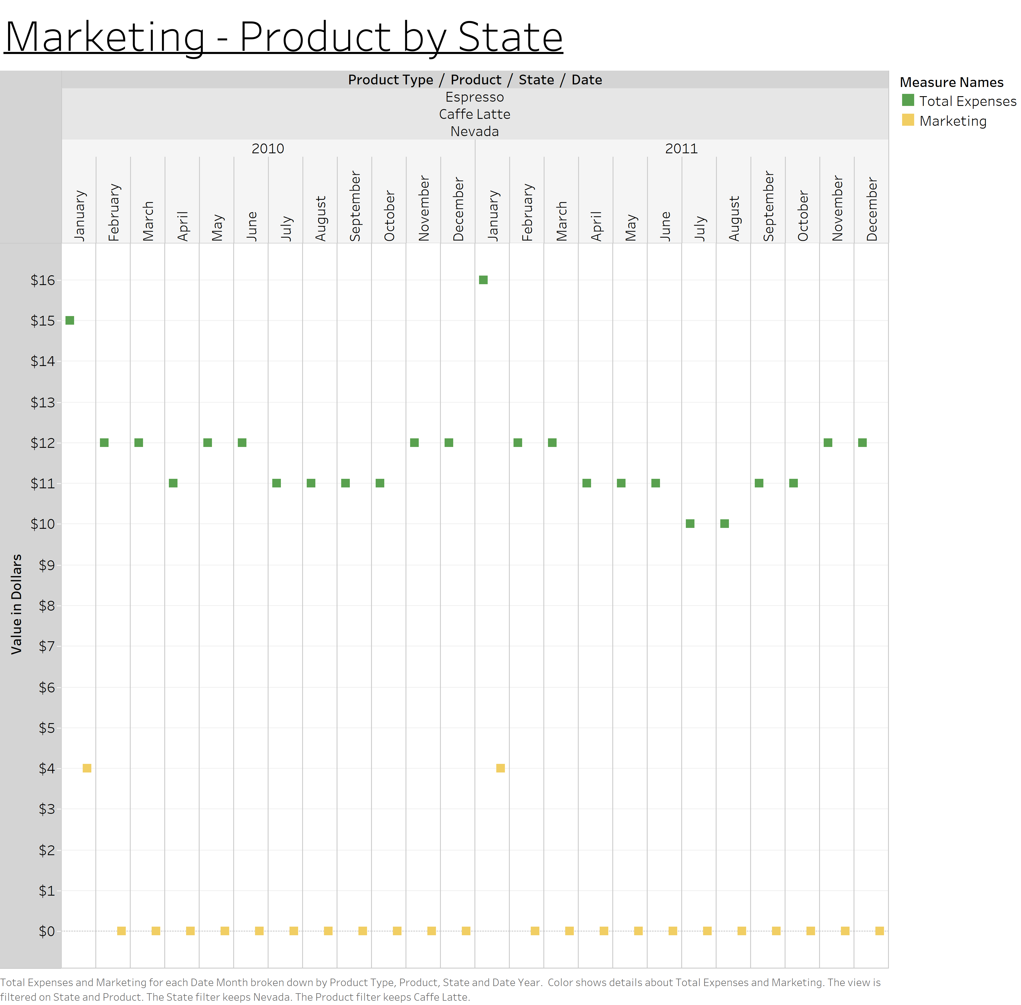
Caffe Latte | Nevada

Slide 38
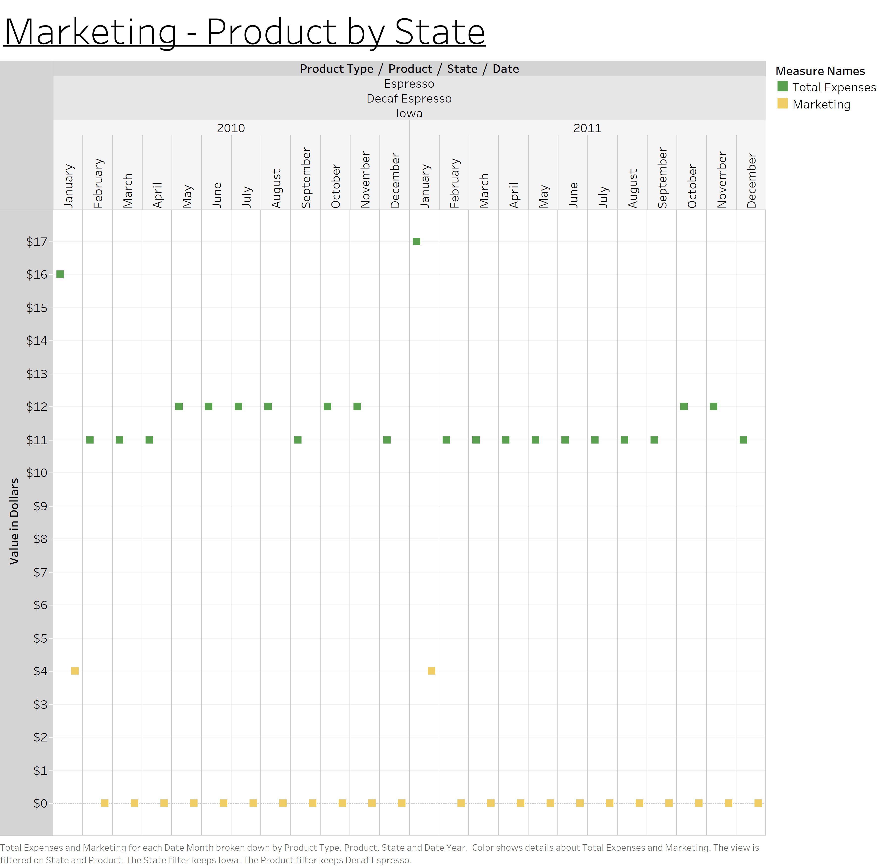
Decaf Espresso | Iowa

Slide 39
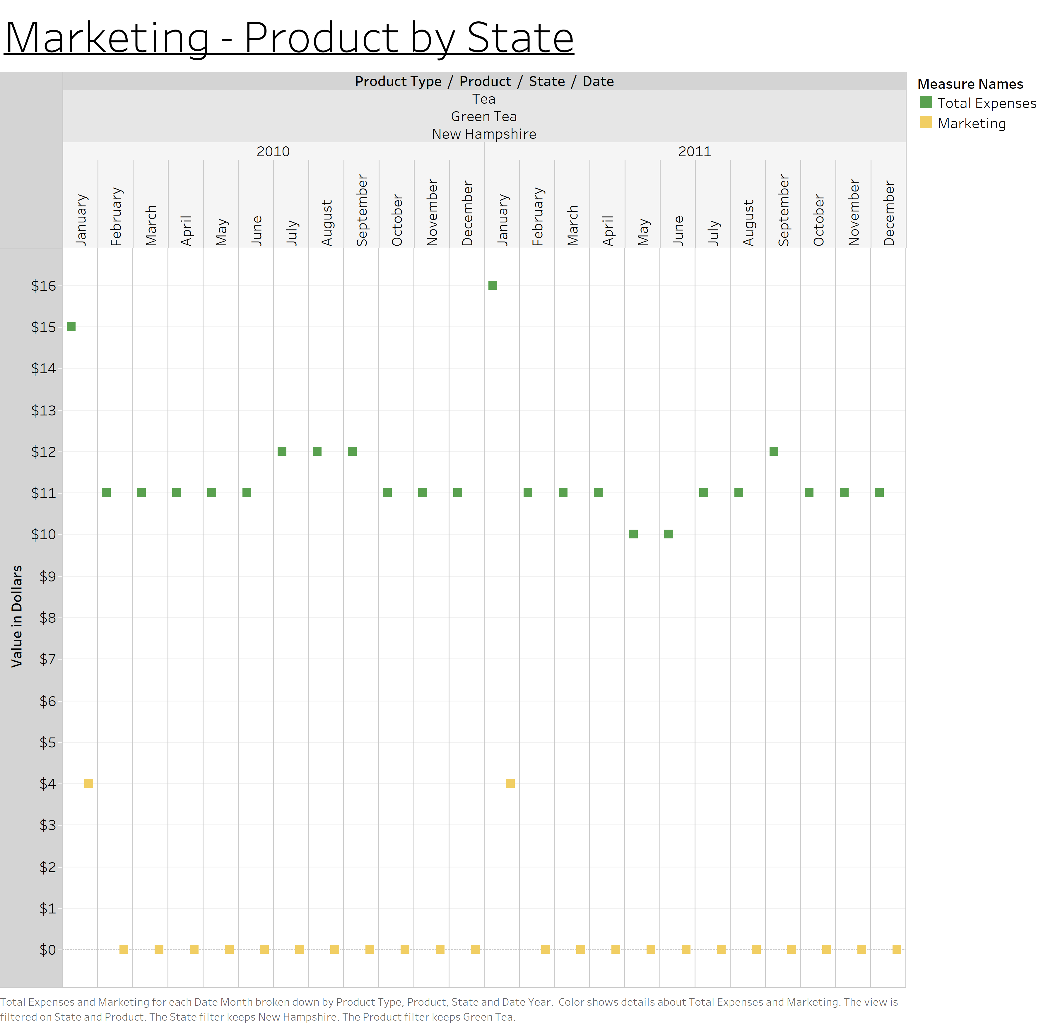
Green Tea | New Hampshire

Slide 40
Issue 2
The second issue that impacts profitability relates to the marketing spend over time for products by state. The products with the lowest profitability are associated with much more marketing spend over time. The products with the highest profitability are associated with much less marketing spend over time.

